Slide 1
SOCIAL COHESION
Mario Guzmán Aza
Alejandra Vargas Coronado

Slide 2

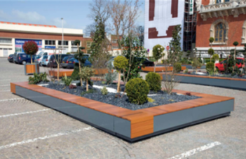
GRIJSEN PARK & STREET DESIGN
Grijsen park & street design was formed on 1989 to produce standard street furniture for parks. They have developed a new form of view about the design of recycle bins and benches, by combining simplicity and comfort they make the products elegant and stylish which is the quality that defines the company.

Slide 3
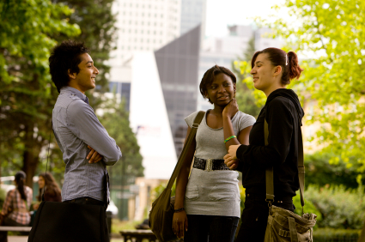
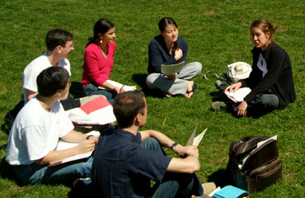
WHAT IS SOCIAL COHESION?
Share, talk, play, laugh. Different aspects of life that we often lose because of the lack of trust that exists in society. To be social is one of the most important characteristics of the human being, because he IS a social being, and it’s the most rewarding way to developed in life.

Slide 4
WHO ARE WE?
GUZMAN & VARGAS
We are a group dedicated to develop new ideas in order to achieve solutions to social problems in our community.
Our main goal is to recreate the idea that all students, no matter faculties or grade, belong to the same educational institution.

Slide 5

WHAT DO WE DO?
GUZMAN & VARGAS
We are using “green” as platform for creating value around new concepts of products, strategies and services so people will become environmental responsible. Also, we are trying to make student exchange ideas through providing a special space separated from all their daily routine.

Slide 6
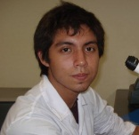
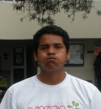
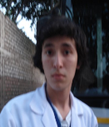
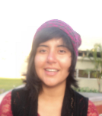
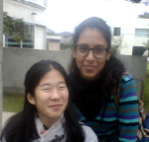
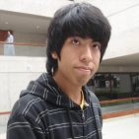
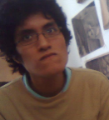
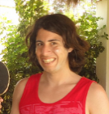
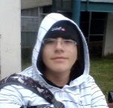
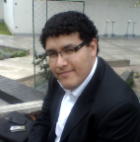
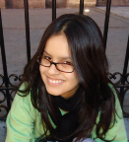
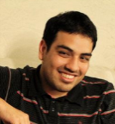
HOW ARE WE GOING TO DO IT?
GUZMAN & VARGAS
We began from the idea to get the attention of different kind of students from the campus in a single place so they can exchange ideas with people that they would normally not interact. This is going to be achieved by creating events in this public and common place.

Slide 8
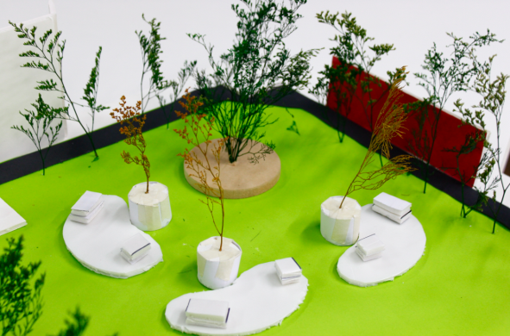
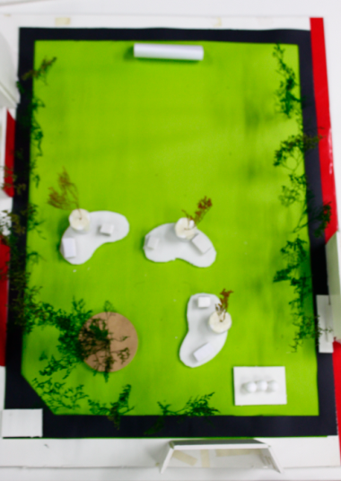
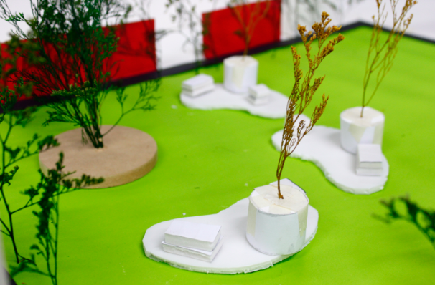
"Green Pot" is made to bring people together, no matter faculties or places. we create events that promote issues that involve all students, which principal characteristic is the ecological aspect and ecofriendly posture.

Slide 9
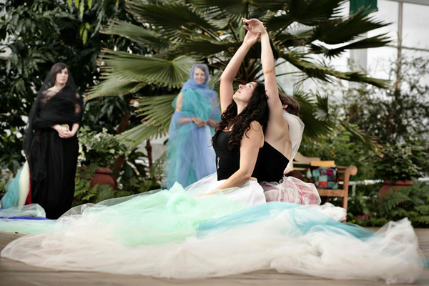

"Green Pot“ will offer different events that promote issues involving all students, which principal characteristic is the ecological aspect and ecofriendly posture.

Slide 10
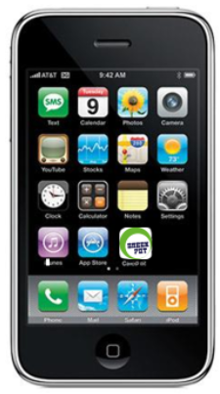
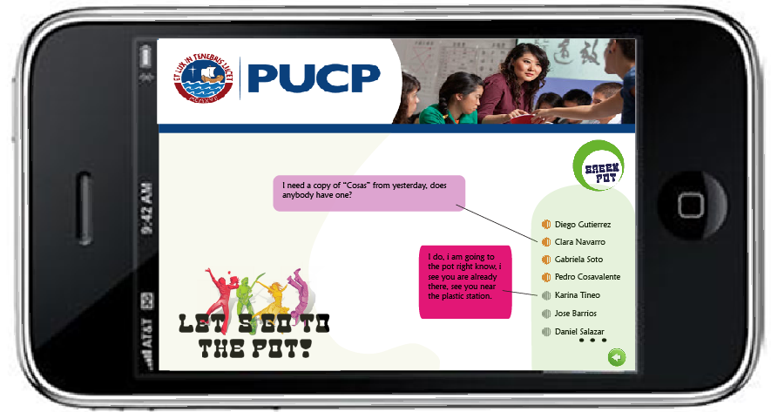
APPLICATION
We are also going to create a system where students could exchange magazine and books they don’t need any more just by signing in a public list in the garden.
This will be on a screen and will go directly to a cellphone application.

Slide 11
FINAL IDEA

Slide 12
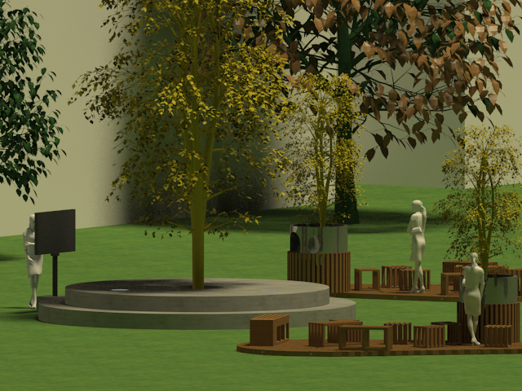

Slide 13
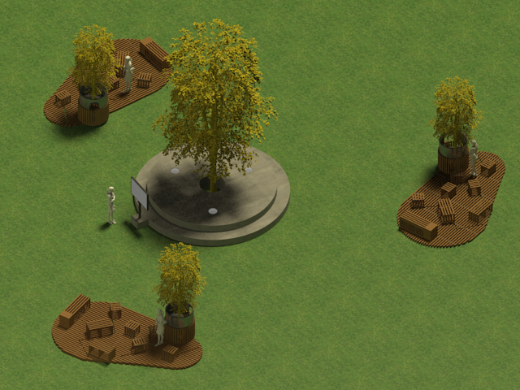
Tree stations surrounding a stage

Slide 14
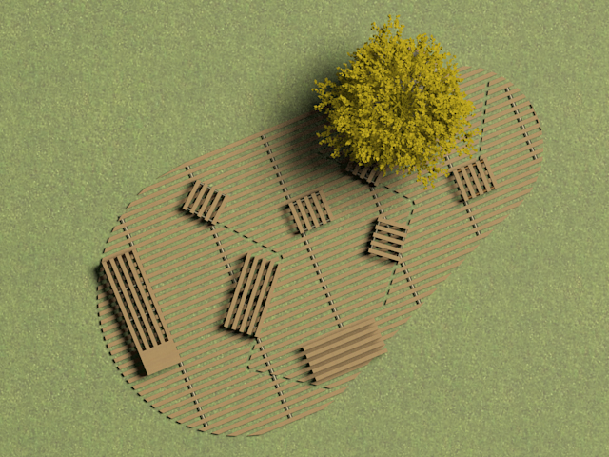
Benches that move around the platform

Slide 15
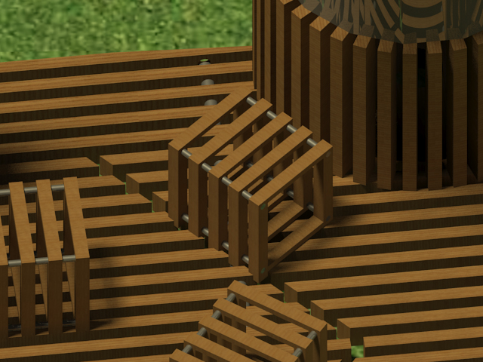
The benches moves because of the tracks

Slide 16
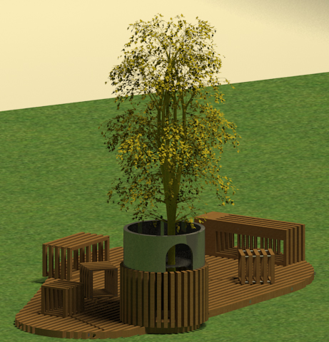
All stations have it’s individual trash bin

Slide 17
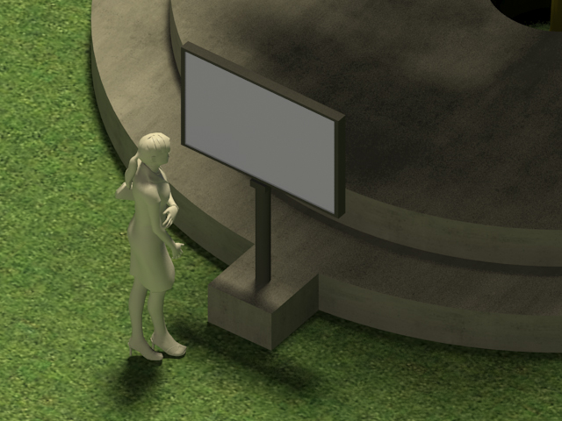
Touch screen with cellphone application

Slide 18
